Slide 1
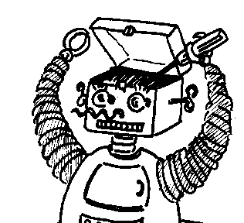
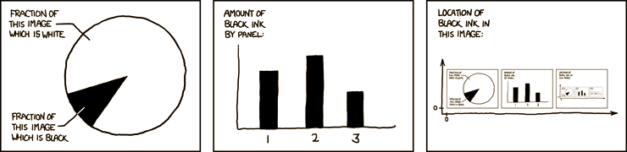

Maryland Metacognition Seminar
http://xkcd.com/
Metacognition for decision support
Marjorie McShane
Computer Science and electrical engineering, UMBC
2 march 2012, 12:00 PM
A. V. Williams Bldg., RM. 3258, College Park
Abstract:
This talk discusses the incorporation of metacognitive abilities into a decision support system in the domain of clinical medicine. The system, called CLAD (CLinician’s ADvisor), will observe a clinician’s interaction with a patient and not only advise the clinician about the next move, but also detect potential decision-making biases on the part of both the clinician and the patient. For example, the clinician’s decision-making might be adversely affected by the small sample bias, false intuitions, base-rate neglect or the exposure effect; similarly, the patient’s decision-making might be compromised by the framing sway, the halo effect or the effect of evaluative attitudes. When CLAD detects a potential bias, it will issue a warning to the clinician along with an explanation of its reasoning – which is actually metareasoning about the agent's model of the reasoning of the clinician or patient. CLAD’s decision support relies on a broad suite of knowledge bases and processors including, non-exhaustively, deep domain modeling, a model of human decision-making, dynamically changing knowledge repositories of the collaborating agents, and semantically-oriented natural language processing.

Slide 2
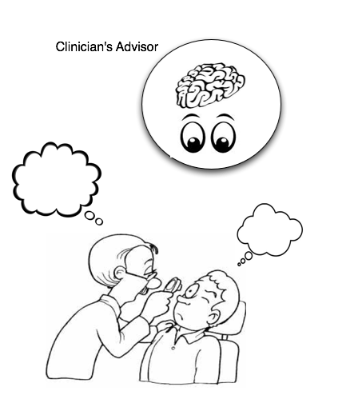
Advising by Imagining What a Live Doctor and Patient are Thinking -- Metacognition

Slide 3
Pointing out to a Clinician Where His or the Patient’s Thinking Might be “Biased”: Metacognition
CLAD can offer this advice by dynamically hypothesizing about the clinician’s and patient’s decision functions (metacognition) and detecting situations in which input parameters to those functions are likely affected by biases.
It can also explain its reasoning (metacognition) to the clinician.

Slide 4
Sample “Biases” to Be Discussed Here
Clinician “biases”
The illusion that more features is better; false intuitions; jumping to conclusions; the small sample bias; base-rate neglect; the illusion of validity; the exposure effect
Patient “biases”
The framing sway; the halo effect; the exposure effect; effects of evaluative attitudes

Slide 5
Kahneman’s Thinking: Fast and Slow (2011)
Daniel Kahneman won the Nobel Prize in economics in 2002 for work (most of it with Amos Tversky) that is very relevant to decision making.
Entertaining book that includes, among other topics, an inventory of decision-making biases and the psychological experiments used to establish their existence.
These biases occur under the radar of human perception, which is why a system like CLAD can be very useful: detect what a clinician might not.

Slide 6
The “Florida Effect”: Priming
Students assembled 4-word sentences out of sets of 5 words
For one group of students, half of the word sets involved “elderly” words: Florida, forgetful, bald, gray, wrinkle
After this experiment, the students were sent down the hall to do another experiment and the walk down the hall was the actual point of the experiment
The students with the elderly words walked down the hall much more slowly than the others.

Slide 7
Predicting Performance at Officer Training School: The Illusion of Validity
The task: attempt to predict which cadets will do well in officer training school in the Israeli army
Evaluators watched a training exercise called the “leaderless group challenge” involving getting everyone over a wall without touching the wall and without the log they could use as a tool touching the wall.
Then the evaluators discussed their impressions, gave numerical scores to each candidate.
Their predictive power was “negligible”.
“We knew as a general fact that our predictions were little better than random guesses, but we continued to feel and act as if each of our specific predictions was valid” (Kahneman 2011: 211) (the illusion of validity).

Slide 8
If we want an intelligent agent to help a live clinician (a) to avoid his own decision-making biases, and (b) to help his patients to avoid biases as well, what capabilities does the intelligent agent need?

Slide 9
Needs of an Expert Clinician Agent
Deep language processing that includes semantic and pragmatic analysis and language generation
Memory modeling and management: own knowledge & model of other agents’ knowledge
Goal and plan management (for self & model of live clinician and live patient): What is the doctor or patient trying to do here? How is he trying to accomplish it? Is he succeeding?
Decision theory, including hybrid reasoning: rule-based, analogy-based, probabilistic
Understanding of agent individualization according to character traits (courage, suggestibility, boredom threshold etc.), personal preferences (likes coffee, is afraid of surgery, etc.), differing knowledge of the world, etc.
Learning of facts, concepts and language by being told, by reading and by experience
The ability to model a patient as a physiological simulation + interoception

Slide 10
Aspects of the Environment: OntoAgent (feasibility is central)
Use of a shared metalanguage of description for agent reasoning, learning and language processing
Use of shared knowledge bases for the above-mentioned capabilities
Integrating complex multi-purposes knowledge systems
Systems that address ergonomic issues for developers and subject matter experts, such the development of a variety of efficiency-enhancing toolkits

Slide 11
This is Some To-Do List!
Demand-side R&D, “do what needs to be done” approach, attempting to solve a problem that has been delineated from outside of AI
Contrast with supply-side R&D: delineate a topic you like (and that promises short-term results) and assume that a use will be found for it or for component methods
Trade-offs: supply-side vs. demand-side
Easy vs. difficult evaluation
Broad vs. narrow coverage
Short-term vs. long-term vision
Narrow vs. big picture

Slide 12
The Good News: We’ve Done a Lot of This Already
The OntoAgent environment exists
It includes modeling of “double” (physiological and cognitive) agents
It includes deep NLP to best support users
It uses a non-toy knowledge substrate: ontology (9000 concepts); lexicon (30,000 senses); fact repository (populated on the fly)
All knowledge resources, processors and decision functions use the same ontologically grounded, unambiguous metalanguage
E.g., NLP involves “English > metalanguage > English” translations, with decision making, memory management taking place in the metalanguage.
We have two proof-of-concept application systems: Maryland Virtual Patient (MVP) and CLinician’s ADvisor (CLAD)
The psychologically-motivated decision-making enhancements discussed here are actually enhancements for existing systems

Slide 13
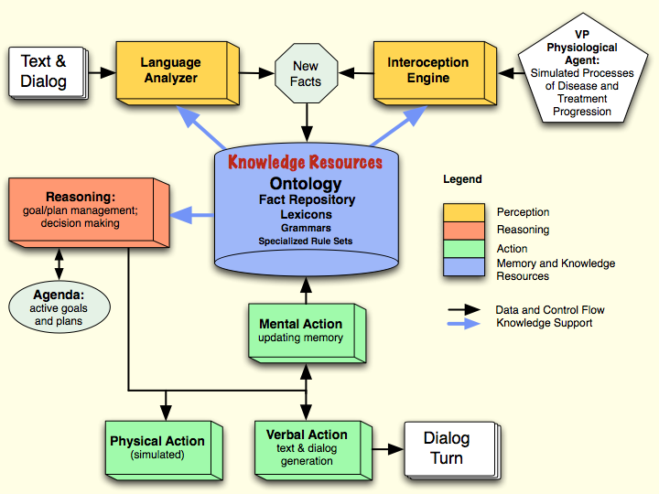
Cognitive Agent Architecture

Slide 14
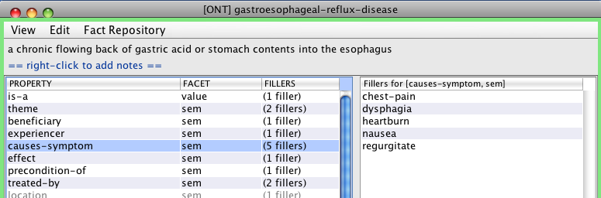
Ontology

Slide 15
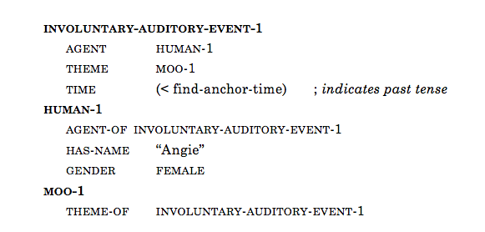
Angie heard a moo.

Slide 16
What’s To Come
Brief overview of MVP and CLAD: why decision-oriented metacognition is an enhancement, not pie in the sky
Detecting clinician “biases” and flagging the clinician about them
Detecting patient “biases” and flagging the clinician about them
The clinician must help the patient to make responsible decisions in a patient-centered paradigm.

Slide 17
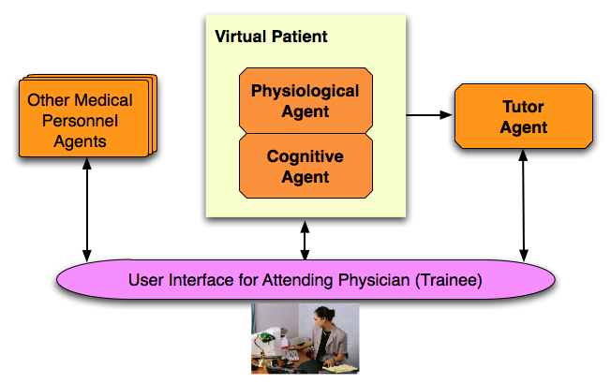
Maryland Virtual Patient (MVP)

Slide 18
The Goal
Have physicians recognize this as a tree…
Users of the SHERLOCK II system for learning F16 aircraft troubleshooting were reported to have learned more in 20 hours of tutoring than in 4 years of field experience (Evens and Michael, 2005)

Slide 19
The Main Interaction Screen

Slide 20
Under the Hood

Slide 21
A Tutoring Intervention

Slide 22
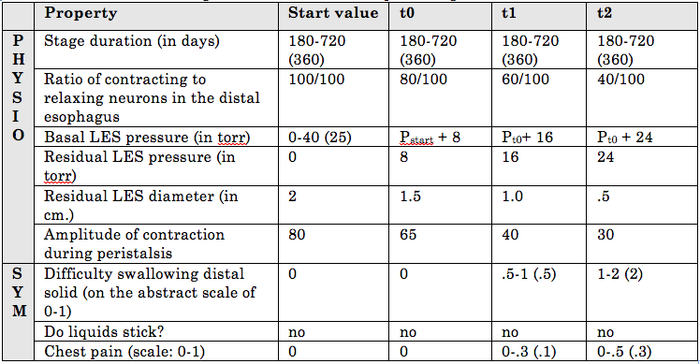
Disease Modeling: Excerpt from Achalasia

Slide 23
Why is MVP Important?
MVP requires A LOT of knowledge: physiological, clinical, language processing, decision-making…
MVP directly gave rise to CLAD: a reconfiguration of a generic language-enabled, decision-making agent, lacking a body (no need for one)
It is all this knowledge that makes the next steps toward psychological sophistication very clear.

Slide 24
Back to CLAD

Slide 25
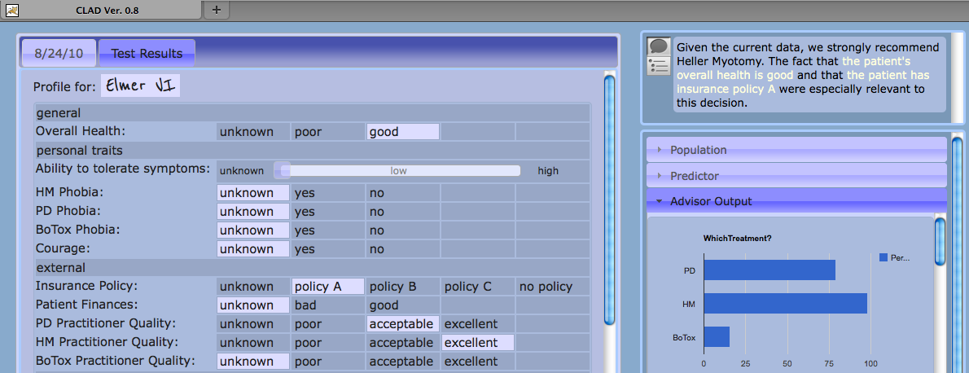
The GUI

Slide 26
Currently, CLAD learns input from the chart only.
We are planning to have it follow the conversation as well. When it does, it will be set to detect clinician and patient biases.

Slide 27
Countering Clinician Biases Using:
Ontological knowledge about diagnosis
Need for more features
Jumping to conclusions
False intuition
Illusion of validity
Disease likelihood
Base rate neglect
Clinician’s past history vs. population-level preferences
Small sample bias
Hype level, clinician history, etc.
Exposure effect
Simulations
Jumping to conclusions
Depletion effects
Small sample bias

Slide 28
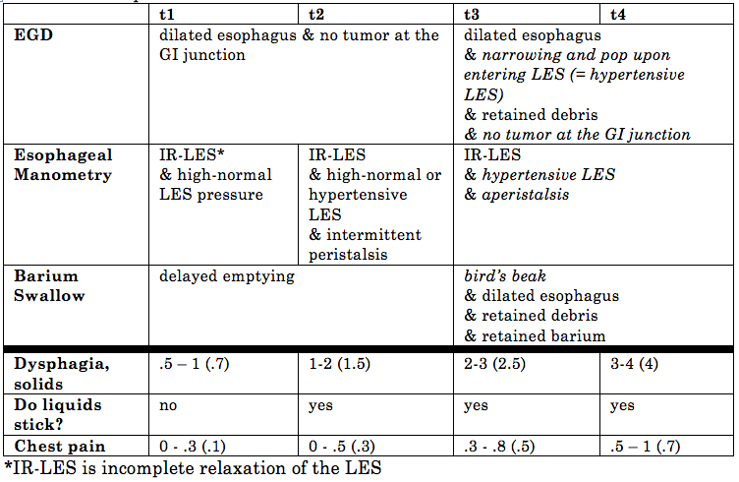
Ontological Knowledge about Diagnosis

Slide 29
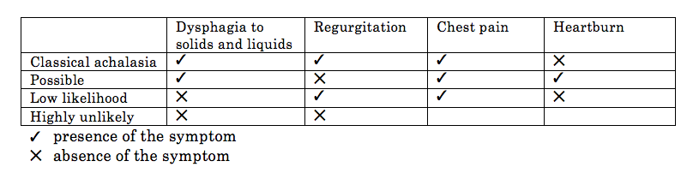
The Predictive Power of Constellations of Features
This is, by its nature, a bit more impressionistic, but reflects the experience of highly experienced practitioners, so is used as yet another source of decision-making power for the system.

Slide 30
“Need for more features” Bias
Experts tend to think that it is useful to think out of the box, include everything about the situation into the decision-making process; but this is more often than not unnecessary and even counterproductive; simple functions are better
Our models can be largely encapsulated in simple tables
If a physician already has enough features to diagnose a disease and sets out to run more tests, CLAD can suggest that the latter is not necessary
Imagine how many features play no role in diagnosing this disease!

Slide 31
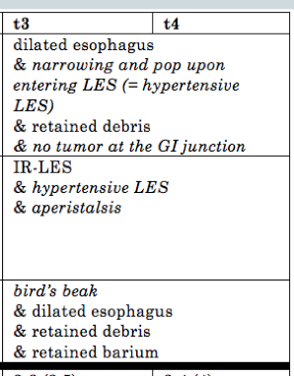
Jumping to Conclusions
Jumping to conclusions saves time and effort and often works; but not always…
All of the italicized features in t3 and t4 are needed for a definitive diagnosis of achalasia
If the clinician posits a diagnosis before all of these features are known, CLAD can issue a warning

Slide 32
False Intuitions
What is intuition?
Following Kahneman [2011: 201-240], we define skilled intuition as recognition of constellations of highly predictive parameter values based on sufficient past experience.
So, intuition comes down to recognizing regularities from past experience.
Compare the predictive power of an anesthesiologist to that of a radiologist: the first has lots of feedback, the second, not.

Slide 33
Recognizing false intuitions
CLAD will evaluate a clinician’s decisions based on:
Clinical aspects of ontology
CLAD’s fact repository about the physician: is he experienced? Does he have enough experience and good outcomes to override “good practice” rules, on the assumption that he is using valid “intuition”?
Should CLAD learn a new constellation of features from an experienced physician?

Slide 34
The Illusion of Validity
Clinging to a belief despite the fact that it is unsubstantiated or there is counterevidence
Cf. the failed “predicting officer potential” method
In clinical medicine: a physician pursues a hypothesis too long, with “too long” defined by:
The strength of the constellation of feature values for this hypothesis
The strength of the constellation of feature values for competing hypotheses
The trustworthiness of tests providing feature values

Slide 35
Countering Clinician Biases Using:
Ontological knowledge about diagnosis
Need for more features
Jumping to conclusions
False intuition
Illusion of validity
Disease likelihood
Base rate neglect
Clinician’s past history vs. population-level preferences
Small sample bias
Hype level, clinician history, etc.
Exposure effect
Simulations
Jumping to conclusions
Depletion effects
Small sample bias

Slide 36
Base-Rate Neglect
Lose sight of likelihood of a disease for a certain kind of person in a certain situation: e.g., malaria unlikely in NYC but highly likely in Africa
Likelihood is ontologically recorded using conditional statements like those on the next slide
If a clinician hypothesizes esophageal carcinoma for a 20-year old patient with a 2-month history of reflux symptoms, CLAD can issue a flag.

Slide 37
esophageal-carcinoma
sufficient-grounds-to-suspect
Both
- (GERD (experiencer patient-1) (duration (> 5 (measured-in year)))
- Either
- (patient-1 (agent-of smoke))
- (patient-1 (agent-of (drink (theme alcohol) (frequency (> .3)))))
- (patient-1 (agent-of (reside (location industrial-place))))
- (patient-1 (agent-of (work (location industrial-place))))
- (patient-1 (experiencer-of (expose (theme carcinogen)
(frequency (> .3)))))
Other conditions…

Slide 38
Countering Clinician Biases Using:
Ontological knowledge about diagnosis
Need for more features
Jumping to conclusions
False intuition
Illusion of validity
Disease likelihood
Base rate neglect
Clinician’s past history vs. population-level preferences
Small sample bias
Hype level, clinician history, etc.
Exposure effect
Simulations
Jumping to conclusions
Depletion effects
Small sample bias

Slide 39
Small Sample Bias
A person’s understanding of the frequency or likelihood of an event can be swayed from objective measures by the person’s own experience, and by the ease to which an example of a given type of situation – even if objectively rare – comes to mind
Beware the art of medicine (incorporating personal experience in informal ways into one’s decision-making)
Kahneman [2011: 118]: “The exaggerated faith in small samples is only one example of a more general illusion – we pay more attention to the content of messages than to information about their reliability, and as a result end up with a view of the world around us that is simpler and more coherent than the data justify.”

Slide 40
Detecting Small Sample Bias
CLAD’s decision function will incorporate:
The physician’s current clinical decision (“Give medication X”)
CLAD’s model of the physician’s past clinical history, particularly with respect to the given decision (“Give medication X vs. Y vs. Z”)
The objective, population-level preference for the selected decision as compared with other options.

Slide 41
Countering Clinician Biases Using:
Ontological knowledge about diagnosis
Need for more features
Jumping to conclusions
False intuition
Illusion of validity
Disease likelihood
Base rate neglect
Clinician’s past history vs. population-level preferences
Small sample bias
Hype level, clinician history, etc.
Exposure effect
Simulations
Jumping to conclusions
Depletion effects
Small sample bias

Slide 42
The Exposure Effect
People believe frequently-repeated falsehoods because, as Kahneman [2011: 62] says, “familiarity is not easily distinguished from truth”.
This is biologically grounded in the fact that if you’ve encountered something many times and are still alive, it is probably not dangerous [ibid: 67].

Slide 43
CLAD’s Detection of the Exposure Effect
CLAD’s detection function will include the properties:
HYPE-LEVEL: derived from amount of advertising, free-samples, etc.
The objective “goodness” of the intervention – as compared with alternatives – at the level of population, which is a function of its relative efficacy, side effects, cost, etc.
The objective “goodness” of the intervention – as compared with alternatives – for this patient, which adds patient-specific features, if known, to the above calculation.
The actual selection of an intervention for this patient in this case.
The doctor’s past history of prescribing – or not prescribing – this intervention in relevant circumstances.
Is the doctor being influenced by hype? Is he set in old ways?

Slide 44
Countering Clinician Biases Using:
Ontological knowledge about diagnosis
Need for more features
Jumping to conclusions
False intuition
Illusion of validity
Disease likelihood
Base rate neglect
Clinician’s past history vs. population-level preferences
Small sample bias
Hype level, clinician history, etc.
Exposure effect
Simulations
Jumping to conclusions
Depletion effects
Small sample bias

Slide 45
Using Simulations to Counter Prognosis Biases
Say a patient asks the doctor for his prognosis
The doctor might be tired (depletion effects) or not sufficiently familiar with the possible manifestations of the disease (small sample bias, jumping to conclusions) to present the full scope of likely outcomes
CLAD can help by offering simulations of hypothetical virtual patients
Neither overconstrain nor overgeneralize in predictions about patient prognoses

Slide 46
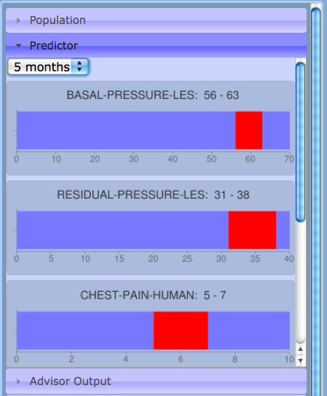
Predictor, like Battleship Game

Slide 47
Now we turn to patient “biases”
Detecting clinician “biases”
Illusion that more features is better; false intuitions; jumping to conclusions; small sample bias; base-rate neglect; illusion of validity; exposure effect
Detecting patient “biases”
Framing sway; halo effect; exposure effect; effects of evaluative attitudes

Slide 48
The Goal: Patient-Centered Medicine
Collaboration between doctor and patient
Help patient to make best, most informed decisions (saying “OK” to everything the doctor says with no understanding of it is not the idea)
Say the doctor recommends a medication to the patient that is highly effective and has few, rare side effects, which the doctor names. The patient refuses.
Rather than badger the patient the doctor – and CLAD – should figure out what might be going on.

Slide 49
Parameters in a Generic Medication-Oriented Decision Function
the list of potential benefits, risks and side effects and, for each, its intensity (how beneficial is it?), importance, and likelihood
the cost, in terms of money, time, emotional drain, etc.
the patient’s trust in the doctor’s advice
the patient’s beliefs in a more general sense – about medication use overall, being under a physician’s care, etc.

Slide 50
Back to Our Example
Say the drug that the doctor recommended was hypothetical drug X, used for headache relief
The doctor described the drug to the patient as follows: “It is very likely that this drug will give you significant relief from your headaches and it might also improve your mood a little. The most common side effect is dry mouth, and there is a small chance of impotence. Unfortunately, the drug has to be injected subcutaneously twice a day.”

Slide 51
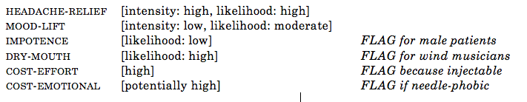

What the Doctor and CLAD will Know, 1 of 2

Slide 52
What the Doctor and CLAD will Know, 2 of 2
Patients are susceptible to decision-making biases like:
The exposure effect. Internet, TV, drug ads… From this, the patient’s impression of the medication might involve a vague but lengthy inventory of side effects that the doctor did not mention, and these might serve as misinformation in the inventory of parameters used in the patient’s decision function.
The effect of small samples. The patient might know somebody who took this medication and had a bad time with it.
The effect of evaluative attitudes. The patient might not like the idea of taking medication at all; or he might not like the idea of some class of medications due to a perceived stigma (e.g., against antidepressants); or he might be so opposed to a given type of side effect that its potential overshadows any other aspect of the drug.
Depletion effects. The patient might be tired or distracted when making his decision and he might consider saying ‘no’ to be the least risk option; or his fatigue might have caused lapses in attention so that he misremembered the doctor’s description of the medication.

Slide 53
What CLAD can do
Alert clinician of flag properties
Suggest questions to ask the patient (Is the possibility of impotence of great concern?) or issues to discuss (Have you heard bad things about this drug, for example, on TV?)

Slide 54
Countering the Halo Effect
The tendency to assess a person positively or negatively cross-the-boards on the basis of just a few known positive or negative features: If this person is nice and attractive, I’m sure he is generous too.
Kahneman [2011: 83]: “...The halo effect increases the weight of first impressions, sometimes to the point that subsequent information is mostly wasted.”
If a patient accepts or rejects some advice with little knowledge about it, he might be acting under the halo effect – i.e., not maximally responsibly.

Slide 55
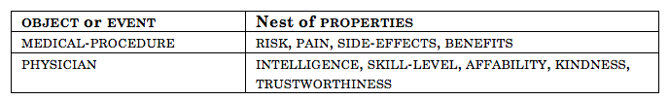
Detecting the Halo Effect
Halo property nests
Each property value is positive-halo, negative-halo or neutral-halo
If n members of a nest are positive-halo and others are unknown, patient might be assuming them to be the same polarity.

Slide 56
Dialog-Oriented Biases
If a person is asked “Doesn’t something hurt right now?” he will have tendency to seek corroborating evidence – something that actually hurts a little
the confirmation bias
If a person is asked, “Your pain is very bad, isn’t it?” he is likely to overestimate his pain because he has been primed with a high pain level
the priming effect
If a person is told, “There is a 20% chance this will fail,” his perception of it will be more negative than if he had been told, “There’s an 80% chance this will succeed”
the framing sway

Slide 57
CLAD’s Detection Methods
Similar to detection of indirect speech acts (It’s cold in here) and ellipsis (I want a dog).
Compile inventory of utterance features; detect them from text meaning representations

Slide 58
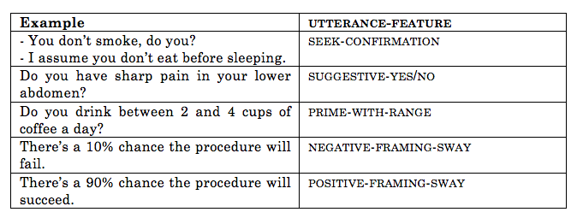

Slide 59
To be a more effective negotiator, frame side effects, risks, etc., using a positive framing sway rather than a negative one.
To get maximally objective ratings of symptoms, neutrally pose symptom-related questions: “Do you have any chest pain?” rather than suggestive-yes/no or prime-with-range.
CLAD can match the most desired utterance types with its assessment of the clinician’s goal in the given exchange, using the tracking of hypothesized goals and plans (e.g., “convince patient to undergo procedure”), formulated in a way similar to the be-healthy goal described above.

Slide 60
About Metacognition
CLAD models
the clinician’s knowledge and decision making
the patient’s knowledge and decision making
the clinician’s understanding of the patient’s knowledge and decision making
It attempt to make explicit to the clinician psychological phenomena that affect decision making.

